Slide 1
Extreme Programming
Matherin Langely · Ryan Rothweiler
ZhenDong Ma · Nikolas Beltran
Notes:
Zhen
Encyclopedia Britannica
FAST Enterprises

Slide 2
Extreme Programming
Extreme Programming:
A Software Development Methodology
A type of agile development.
It has short development lifecycle.
This is used to implement and improve productivity for the customers require.
Traditional ‘good’ programming practices taken to the extreme.
Notes:
Zhen
Extreme programming is doing everything you know you should be doing, but taken to the extreme so you always do it all the time.
Always pair programming. Always unit testing. Always integration testing.
"Extreme" means these practices get "turned up" to a much higher "volume" than on traditional projects. XP ignores any other practice (like BigDesignUpFront) that does not appear on the list. The result is stable, productive, and very rapid because the practices support each other the more they are used together without interference. An Extreme project is typically so stable and sedate it can lead to FortyHourWeeks without any schedule slips.

Slide 3
Extreme Programming
Doing everything you know you should be doing, but taken to the extreme so you always do it all the time.
Always pair programming.
Always unit testing.
Always integration testing.
"Extreme" means these practices get "turned up" to a much higher "volume" than on traditional projects.
XP ignores any other practice (like BigDesignUpFront) that does not appear on the list.
The result is stable, productive, and very rapid because the practices support each other the more they are used together without interference.

Slide 4
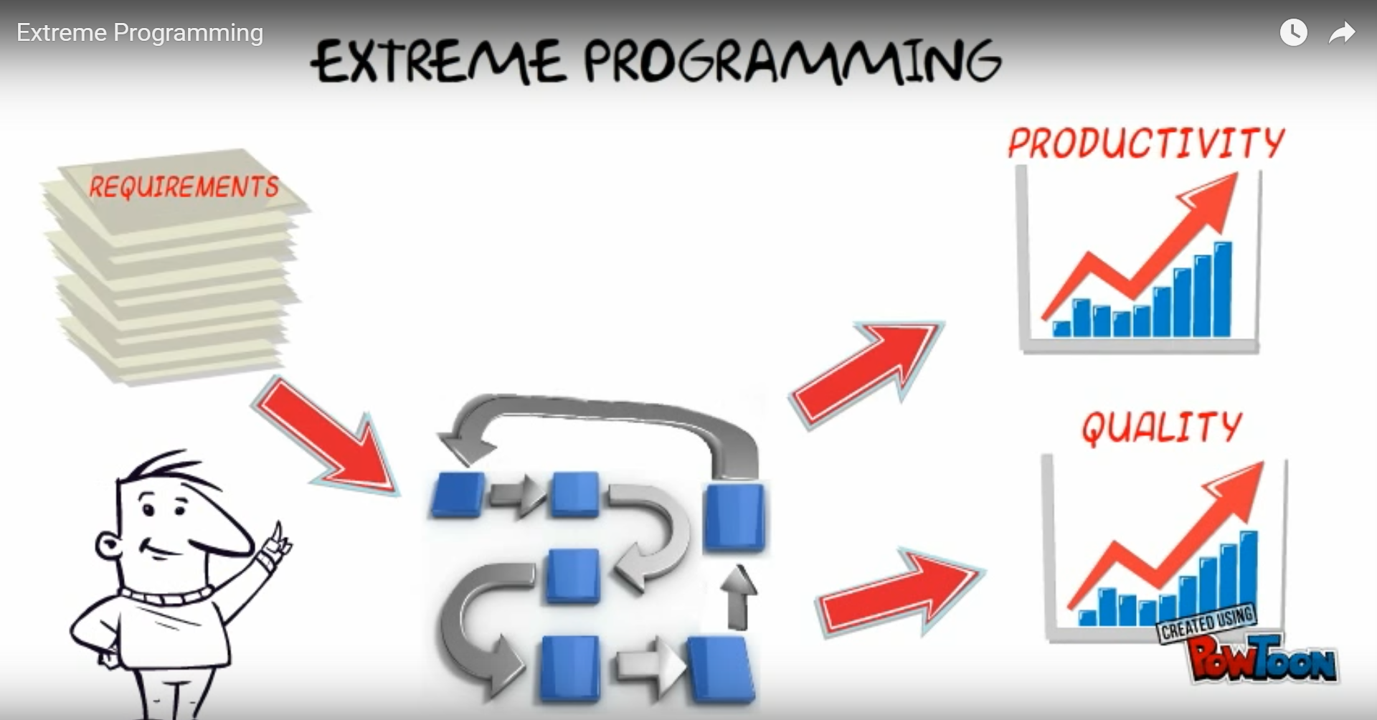
Values of XP
Simplicity
Communication
Feedback
Respect
Courage
Notes:
Zhen
It IS A SOFTWARE DEVELOPMENT methodology, it is short development lifecycle used to implement and improve productivity for the customers require

Slide 5
Rules of Extreme Programming
Planning
User stories are written.
Release schedule created.Frequent small releases.
The project is divided into iterations. Iteration planning starts each iteration
Managing:
open work space.
Sustainable pace.
Stand up meeting
Project Velocity
Move people around.
Fix XP when it breaks.
Designing:
Simplicity
Use CRC cards
Refactor
Coding:
Customers always available.
Be standard.
Unit Testing
Pair Programmed.
Integrates code at a time
Testing:
All code must have unit tests.
Pass unit tests before released.
Tests are created when bug is found.
Notes:
Zhen
Rules are based on the values. Planning User stoories are written. Release planning creates the release schedule.make frequent small releases. The project is divided into iterations. Iteration planning starts each iteration
Managing: open work space. Sustainable pace. Stand up meeting Project Beloctiy Move people around. Fix XP when it breaks.
Designing: simplicity.Use CRC cards.Spkie solutions. Refactor.
Coding:customer Always available. Be standards. Unit test first. Pair programmed.Itegrates code at a time. Integrate often.
Testing All code must have nit tests. Pass unit tests before released. Tests are created when bug is found.

Slide 6
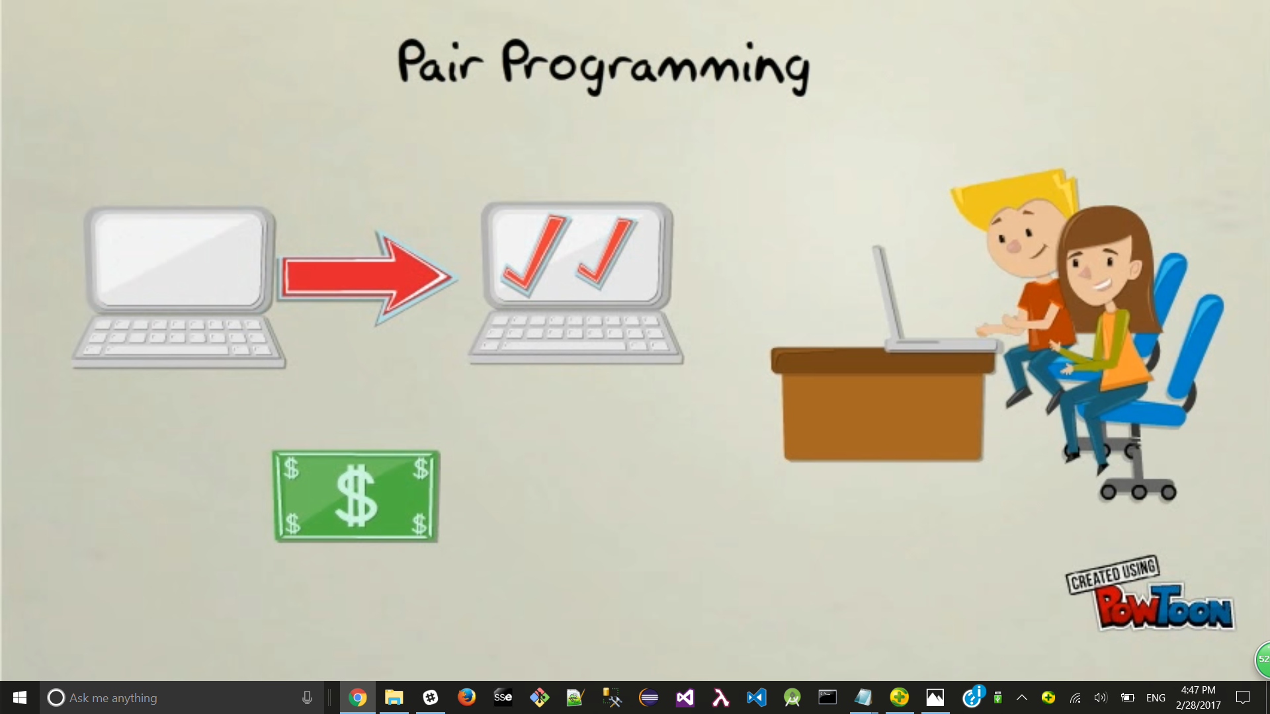
2 person working at one single computer at the same time, there are 2 rolls, navigator and observer, if it does well means less mistake was made and cost business less, one person learn from the other, then, the roll switch. new ideas are encouraged and the code is produced.
Notes:
Zhen

Slide 7
Pair Programming
This technique is where two programmers work together at one workstation. One, the driver, writes code while the other, the observer, reviews each line of code as it is typed
The two programmers switch roles frequently
Benefits
Economics
Satisfaction
Design Quality
Continuous Reviews
Learning
Team Building and Communication
Staff and Project Management
Weaknesses
Does not work for all programmers.
Not reasonable when distance is a factor.
Assumes lack of developer egos and high willingness to cooperate
Large developer skill gap can lead to many problems
Notes:
Zhen
it is a method, that 2 person working at one single computer at the same time, there are 2 rolls, navigator and observer, if it does well means less mistake was made and cost business less, one person learn from the other, then, the roll reverse switch. new ideas are encouraged and the code is produced.

Slide 8
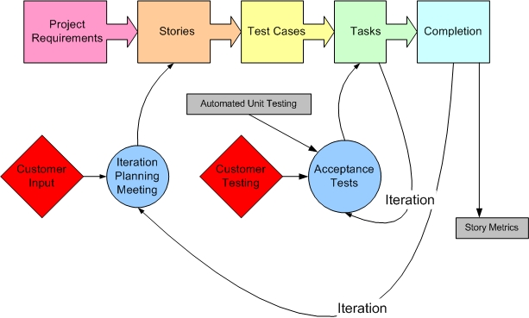
Stories and Test/Requirement-Driven Development
Notes:
Matherin

Slide 9
Stories and Test/Requirement-Driven Development
Project requirements are laid out as stories that have test cases.
A project is done in iterations.
Acceptance tests are performed at the end of each iteration.
Notes:
Matherin

Slide 10
Code Review
This is continuous approach of improvement, used to increase more efficient and clean code.
Code reviews allow programming patterns to be maintained and enforced which leads to increased readability, efficiency, and maintainability of code.
Notes:
Matherin

Slide 11
Code Review
It gives the programmer continuous feedback
Code reviews usually include review team, every so often, coming in to analyze the code.
This forcers any new programmers to be more aware of the bad habits they may have leading to more efficient code
Notes:
Matherin

Slide 12
Unit testing:
Unit testing is a testing process that breaks the parts of the application into individual “units” to be tested independently for proper behavior. This is generally automated.
Easy to test making the program have a higher number of small focus function which is always a benefit
Notes:
Matherin

Slide 13

Notes:
Matherin

Slide 14
Unit Testing:
Each unit has a smallest testable part.
It helps to identify failure of code logic.
Helps identify small easily fixable problems before they become large and expensive.
Notes:
Matherin

Slide 15

Notes:
Ryan
I am going to talk about integration testing

Slide 16
Integration testing
It is an approach where individual modules are combined and tested as a group.
Once two separate parts of the software are completed, they are brought together and tested as a whole.
Notes:
Ryan
Bring smaller pieces together into one piece
Test make sure interfaces between the components work as intended.

Slide 17

Notes:
Ryan

Slide 18

Notes:
Ryan

Slide 19
Integration testing
So this leaves no mistakes, it is the same with making a movie and your scene is added and you played the movie from the start to see if it is working as expected
It significantly lowers the risk of failure and makes sure everything is working together as a whole.
Top down / bottom up
Notes:
Ryan
Much like making a movie.
Two approaches
Top Down. Starting with highest level first and moving down into the unit tests.
Bottom Up. Starts with Unit testing. Make sure each unit is working as intended. Then build up larger and larger test from there.
Usually both are done. Starting with bottom up, once all those pass then top down testing is done.

Slide 20
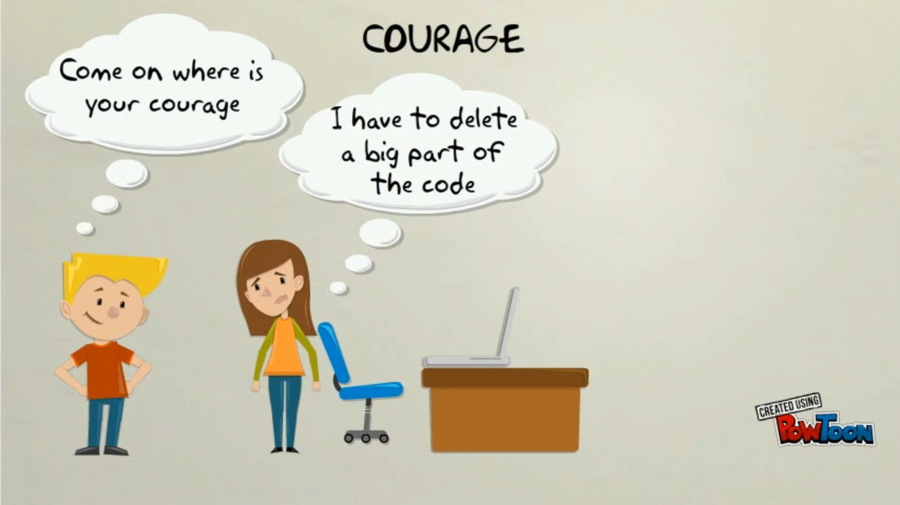
Notes:
Ryan

Slide 21
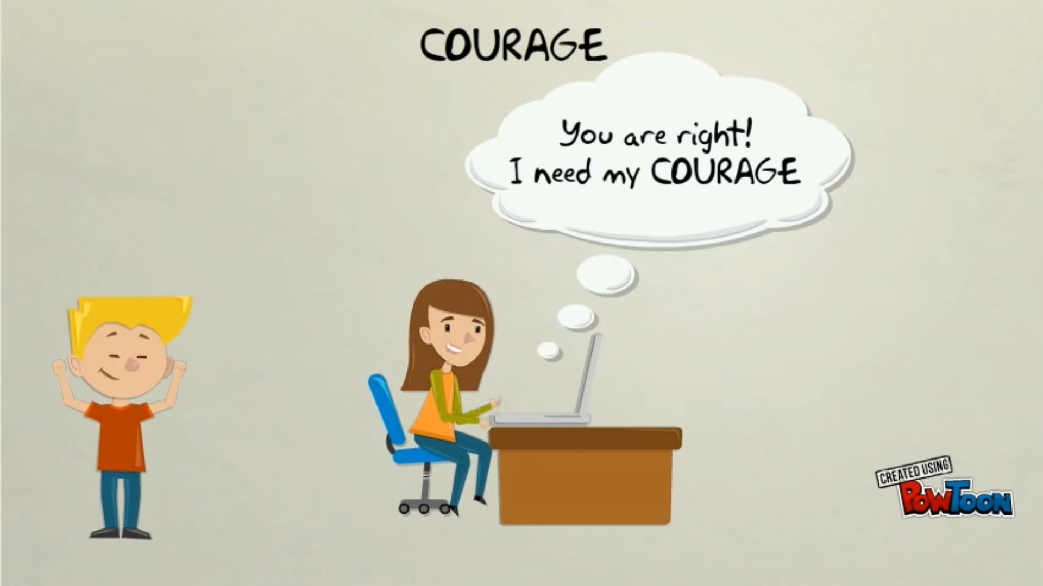
Notes:
Ryan

Slide 22
Courage
This comes into play when important decision need to be made
To change the direction of the project by discarding incorrect decisions.
Not being afraid to make the right decision instead of the easiest or cheapest.
Notes:
Ryan
Having the courage to make the difficult decisions.
Having the courage to adapt to changing project specifications.
Manifests in many ways.

Slide 23
Courage
The team usually has to take responsibility to get rid of code which is no longer useful.
Courage to adapt to changing project requirement.
Possible since you are never working alone.
Notes:
Ryan
Not being afraid to throw way code.
Admitting when you’re wrong.
Having the courage to learn something new
Courage to say no.
Courage to focus only on what is necessary.
Courage to tell the truth about progress
Realize that you are never working alone and that you can always get support

Slide 24
Sustainable Pace
Work on the appropriate number of items per iteration.
Well-rested programmers produce better code.
More working hours does not equal more work done.
Programmer welfare is important and necessary for successful products.
Notes:
http://www.extremeprogramming.org/rules/overtime.html
Productivity drops between 5 and 6 hours per day, just shy of 40 hours a week. Productivity does not reset each new week.
Keep amount of hours worked consistent per iteration.
Consistency helps the team find their perfect project velocity.

Slide 25
Simplicity
Simple code is better than complex code.
Simple is subjective.
Four subjective qualities:
Testable
Browsable
Understandable
Explainable
Notes:
http://www.extremeprogramming.org/rules/simple.html

Slide 26
YAGNA (You Aren’t Gonna Need It)
Only write what you actually need right this moment.
Don’t write what you think you’re going to need.
Refrain from adding extra functionality.
Only 10% of extra stuff will be used.
Constraints will change, so keep your code flexible.
Notes:
http://www.extremeprogramming.org/rules/early.html
https://www.safaribooksonline.com/library/view/extreme-programming-pocket/9781449399849/ch18.html

Slide 27
Problems with Extreme Programming
Having an on-site customer who proposes changes can lead to costly rework and scope creep.
Developers are usually required to work in pairs.
XP only works with twelve or fewer people, although some groups have claimed success with larger numbers.

Slide 28
Applications of Extreme Programming
Extreme Programming is suitable for projects that
involve new technology or rapidly changing requirements
are research projects
are small and easily managed
Traditional methodologies are suitable for projects that
involve stable technology and have fixed requirements
involve mission critical or safety critical mission
are large projects
have complex products that continue beyond the project scope
Notes:
1: or require development to discover unforeseen implementation problems.
2: Are research projects, where the resulting work is not the software product itself, but domain knowledge
3: Are small and more easily managed through informal methods
Involve stable technology and have fixed requirements, where it is known that few changes will occur
Involve mission critical or safety critical systems, where formal methods must be employed for safety or insurance reasons
Are large projects which may overwhelm informal communication mechanisms
Have complex products which continue beyond the project scope to require frequent and significant alterations, where a recorded knowledge base, or documentation set, becomes a fundamental necessity to support the maintenance
Remember to mention Encyclopedia Britannica and FAST Enterprises

Slide 29
Conclusion
Less of a rigorous series of steps and more just a collection of best practices.
Best practices are always strictly enforced.
Best practices taken to the extreme.

